Slide 1


AI-Powered Home Finance Automation: Taming Receipt Chaos with GPT-4
Emiliano Montesdeoca

Slide 2
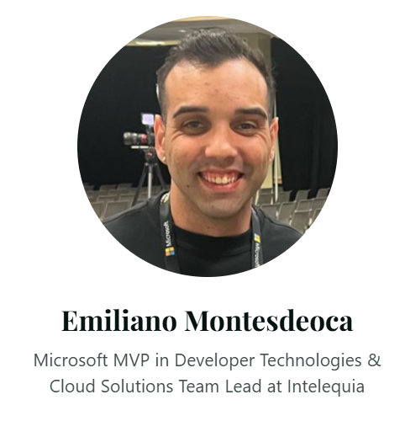
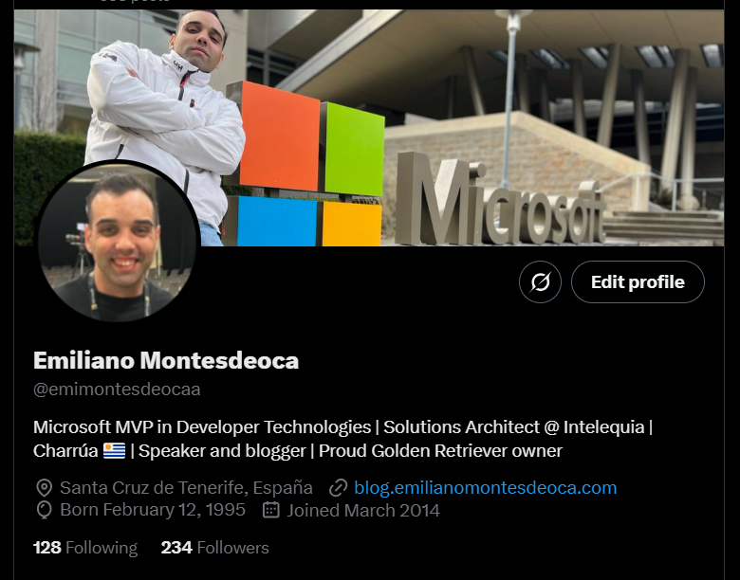
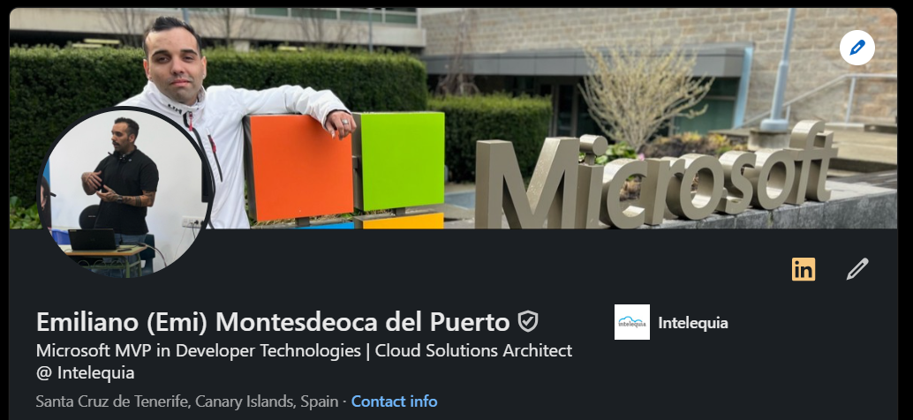
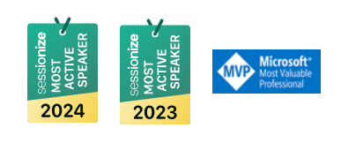

Azure Nigeria Community
@emimontesdeocaa
Notes:
My name is [Speaker name], [Speaker title] at [Speaker company] .
My name is [Speaker name], [Speaker title] at [Speaker company] .

Slide 3
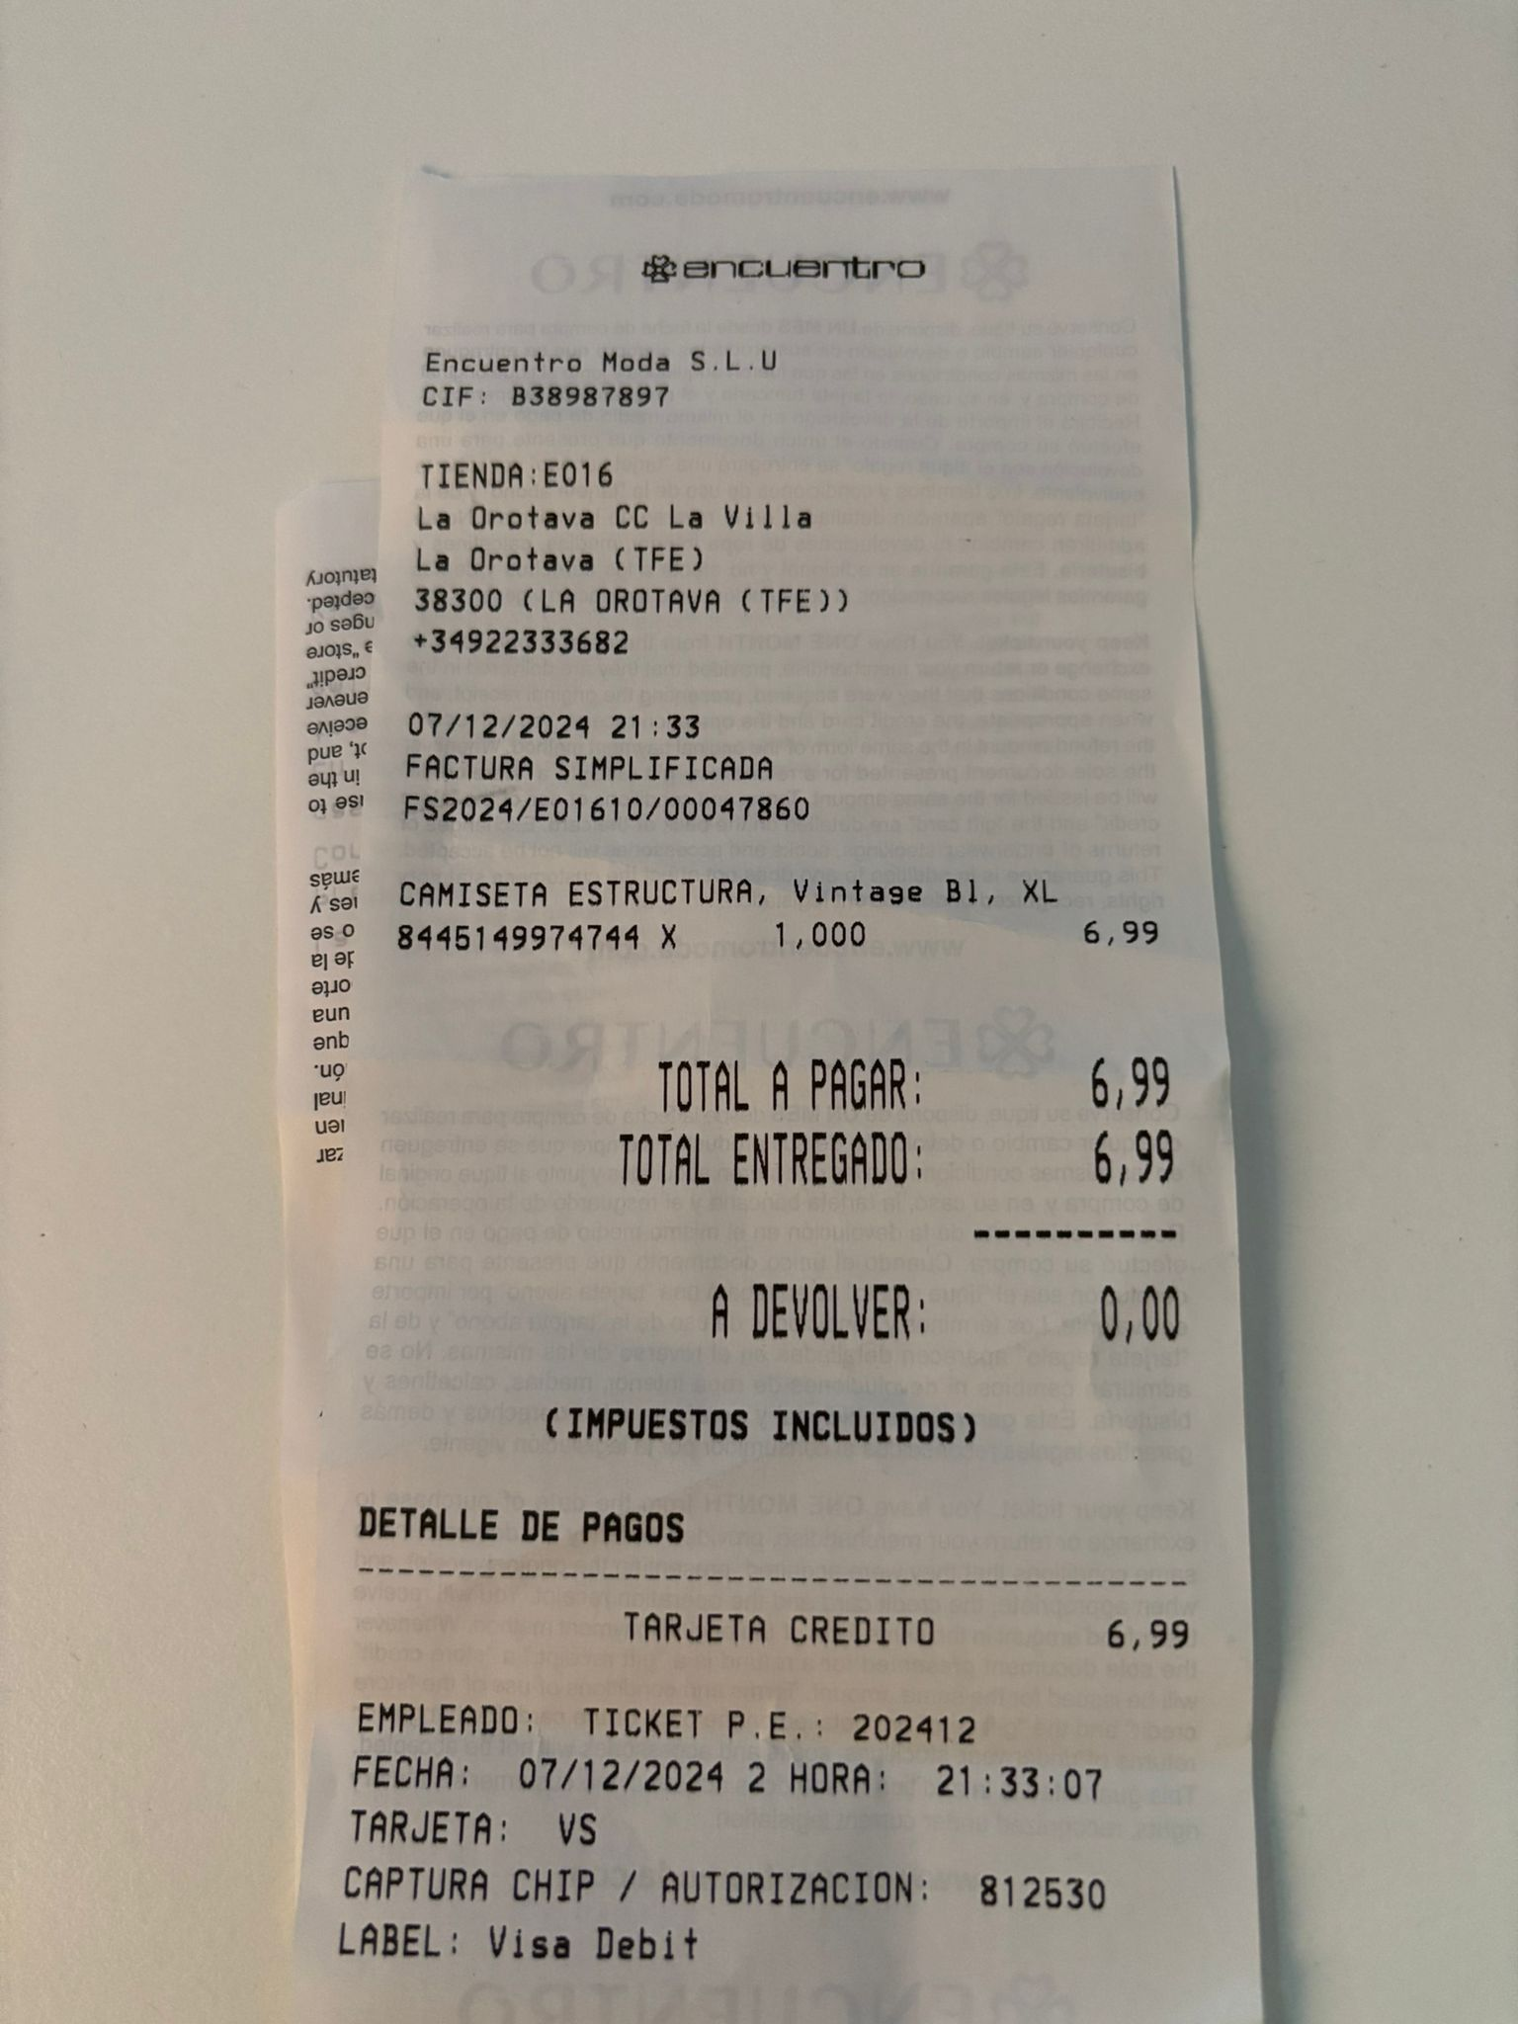
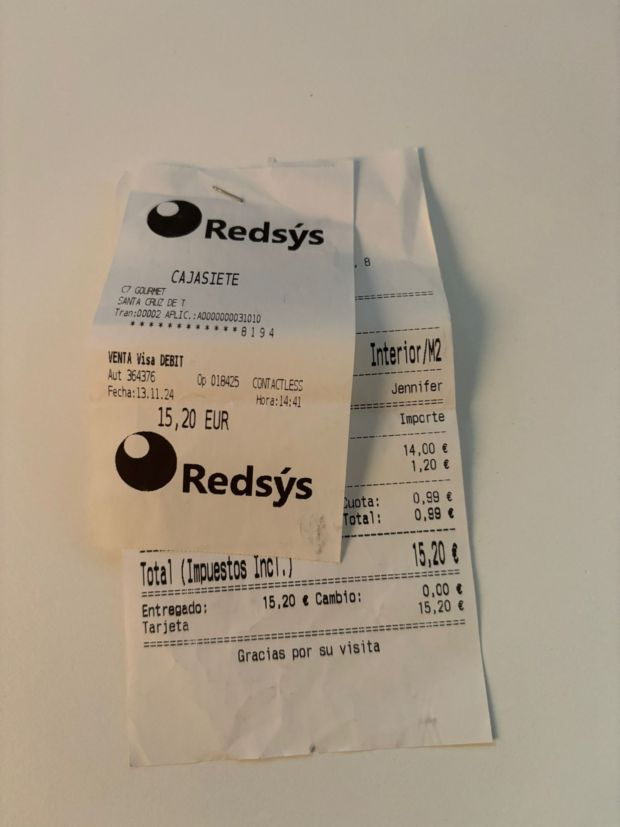
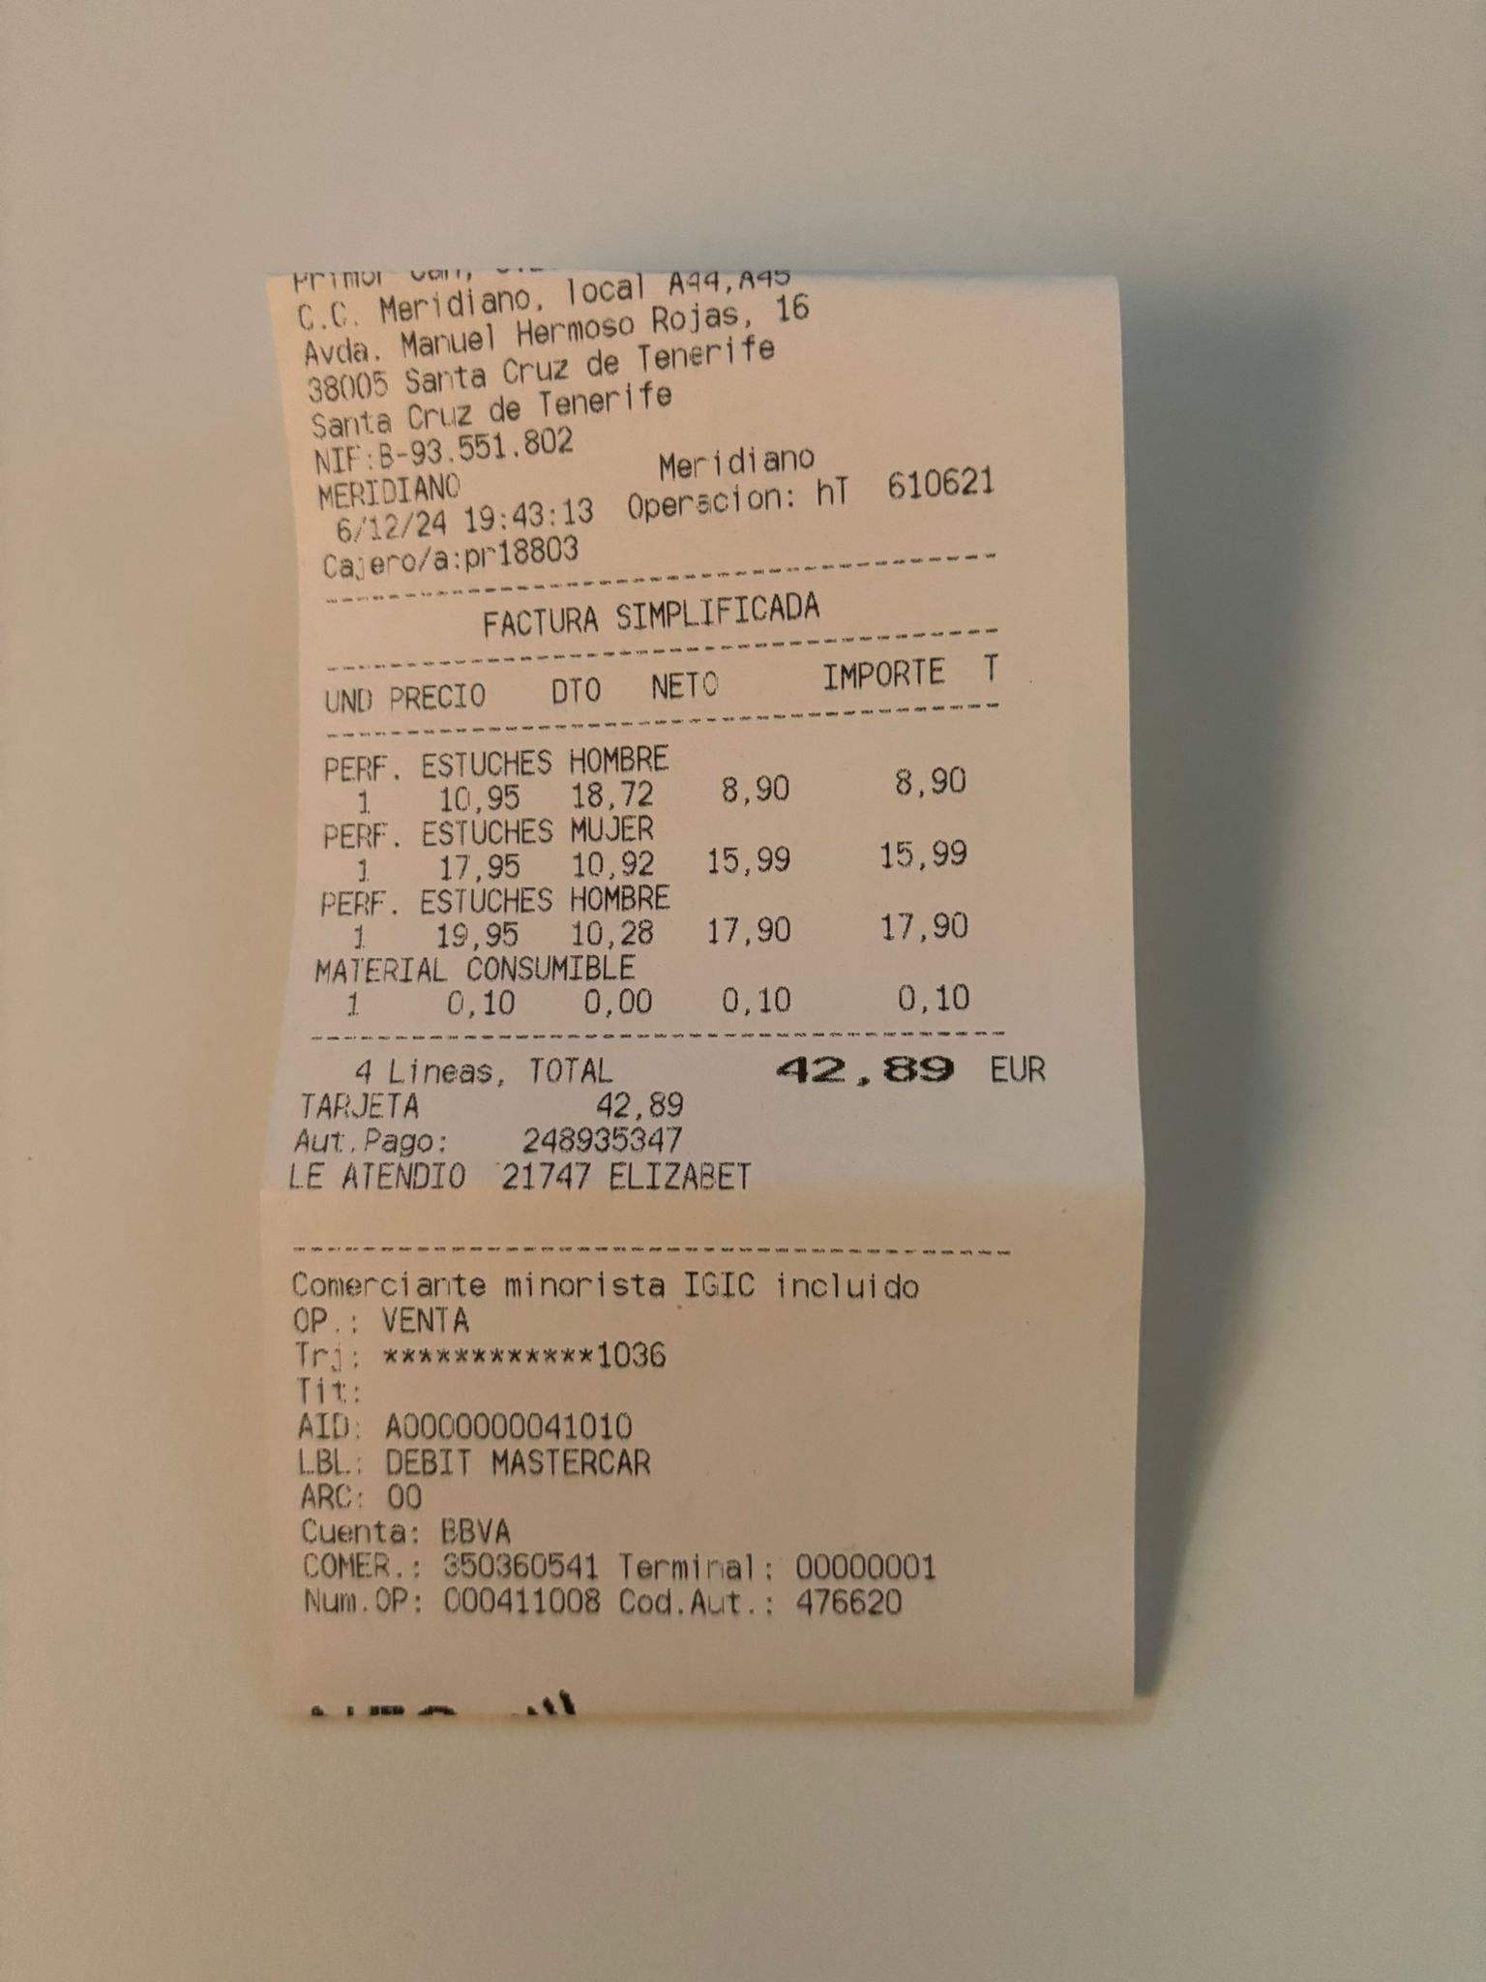
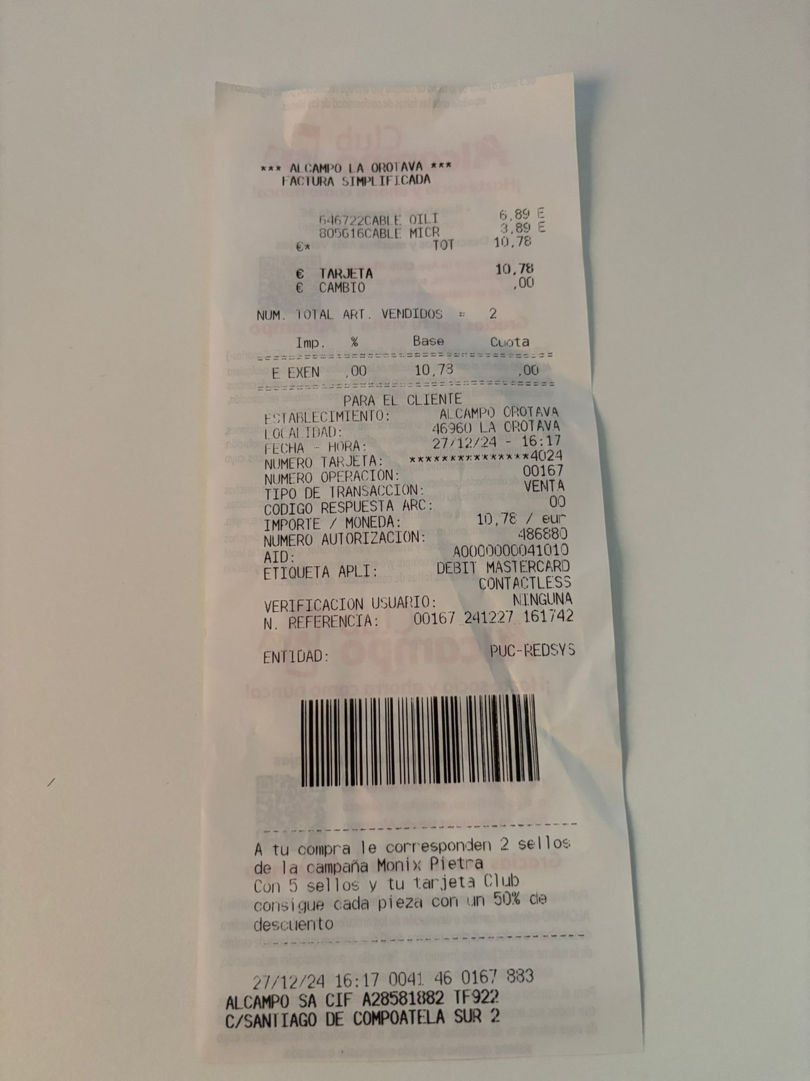
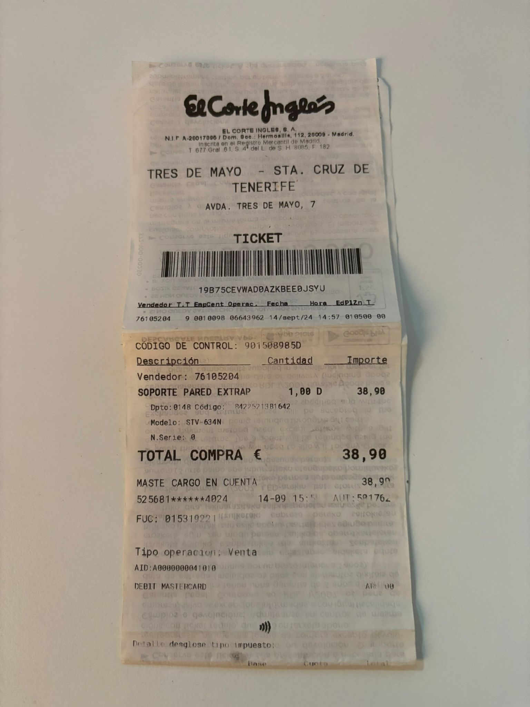
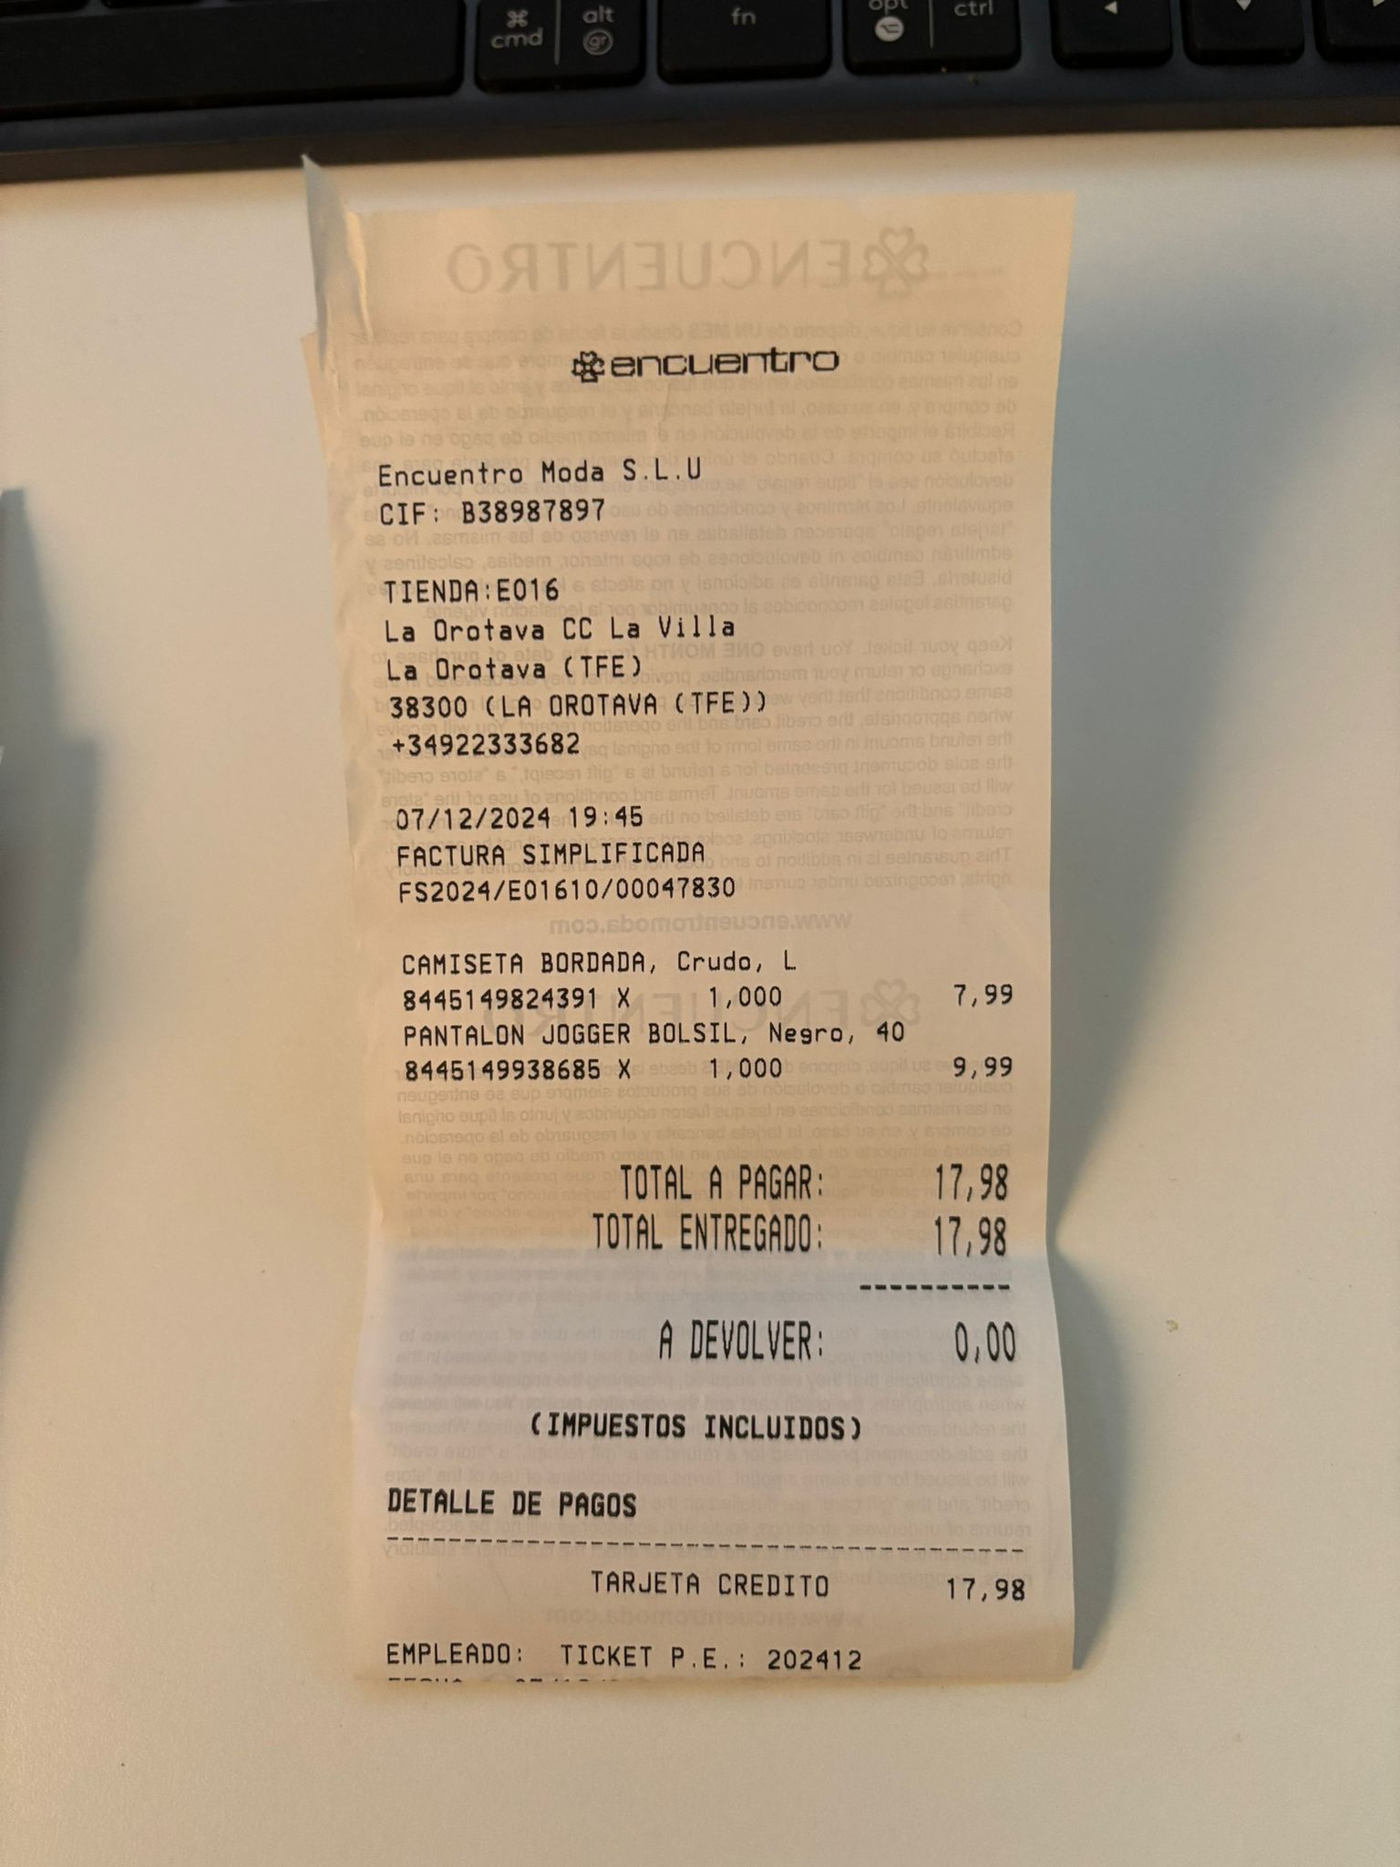
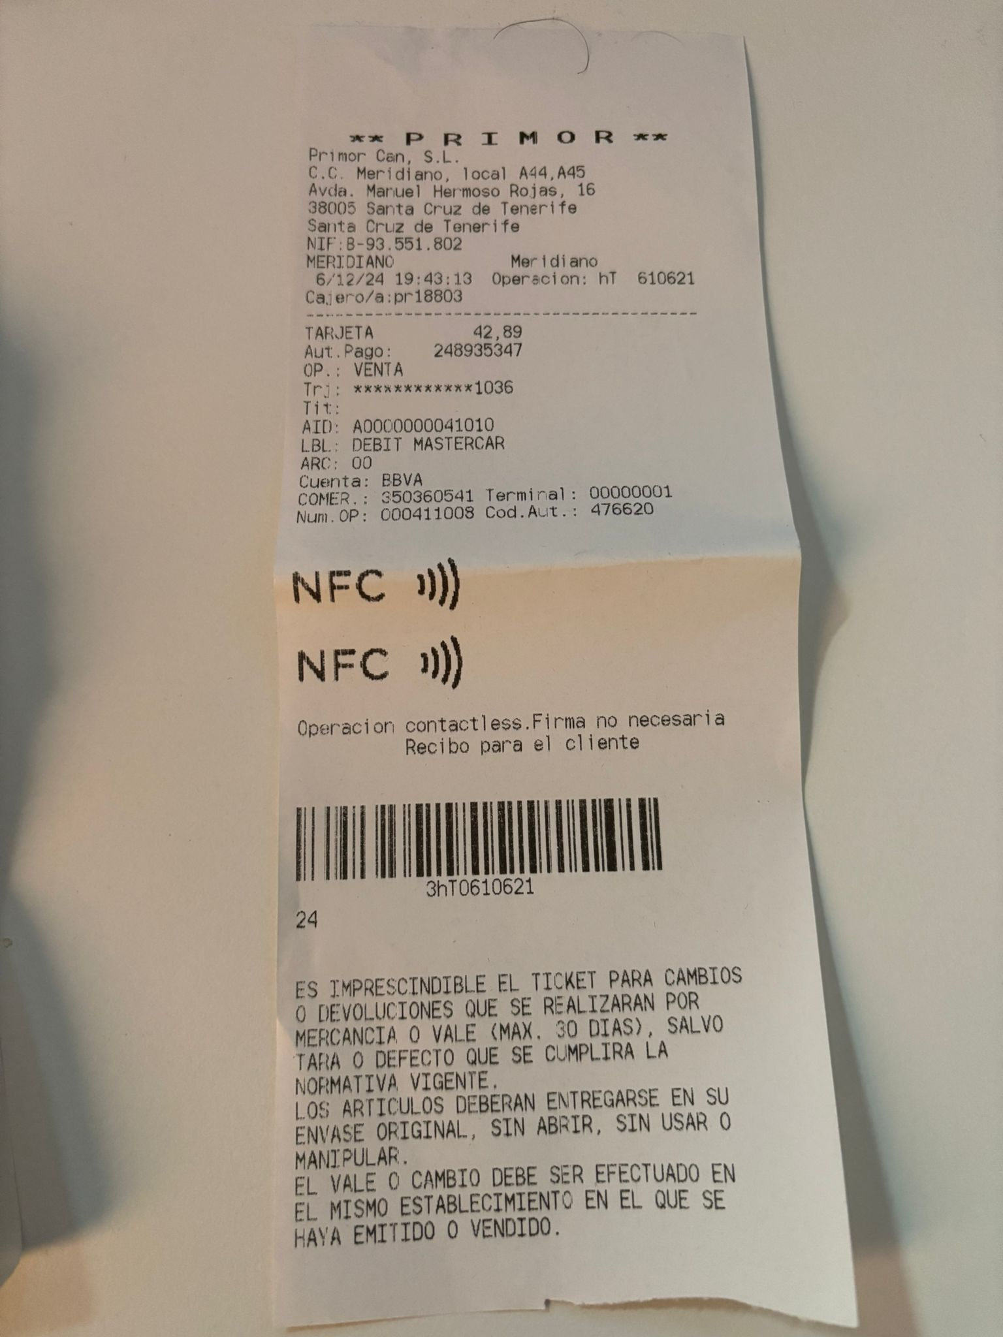
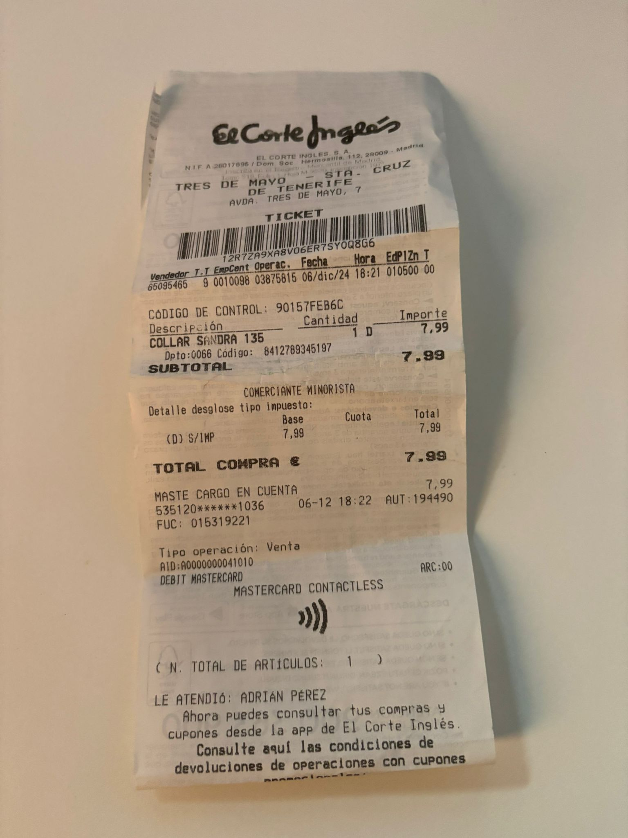
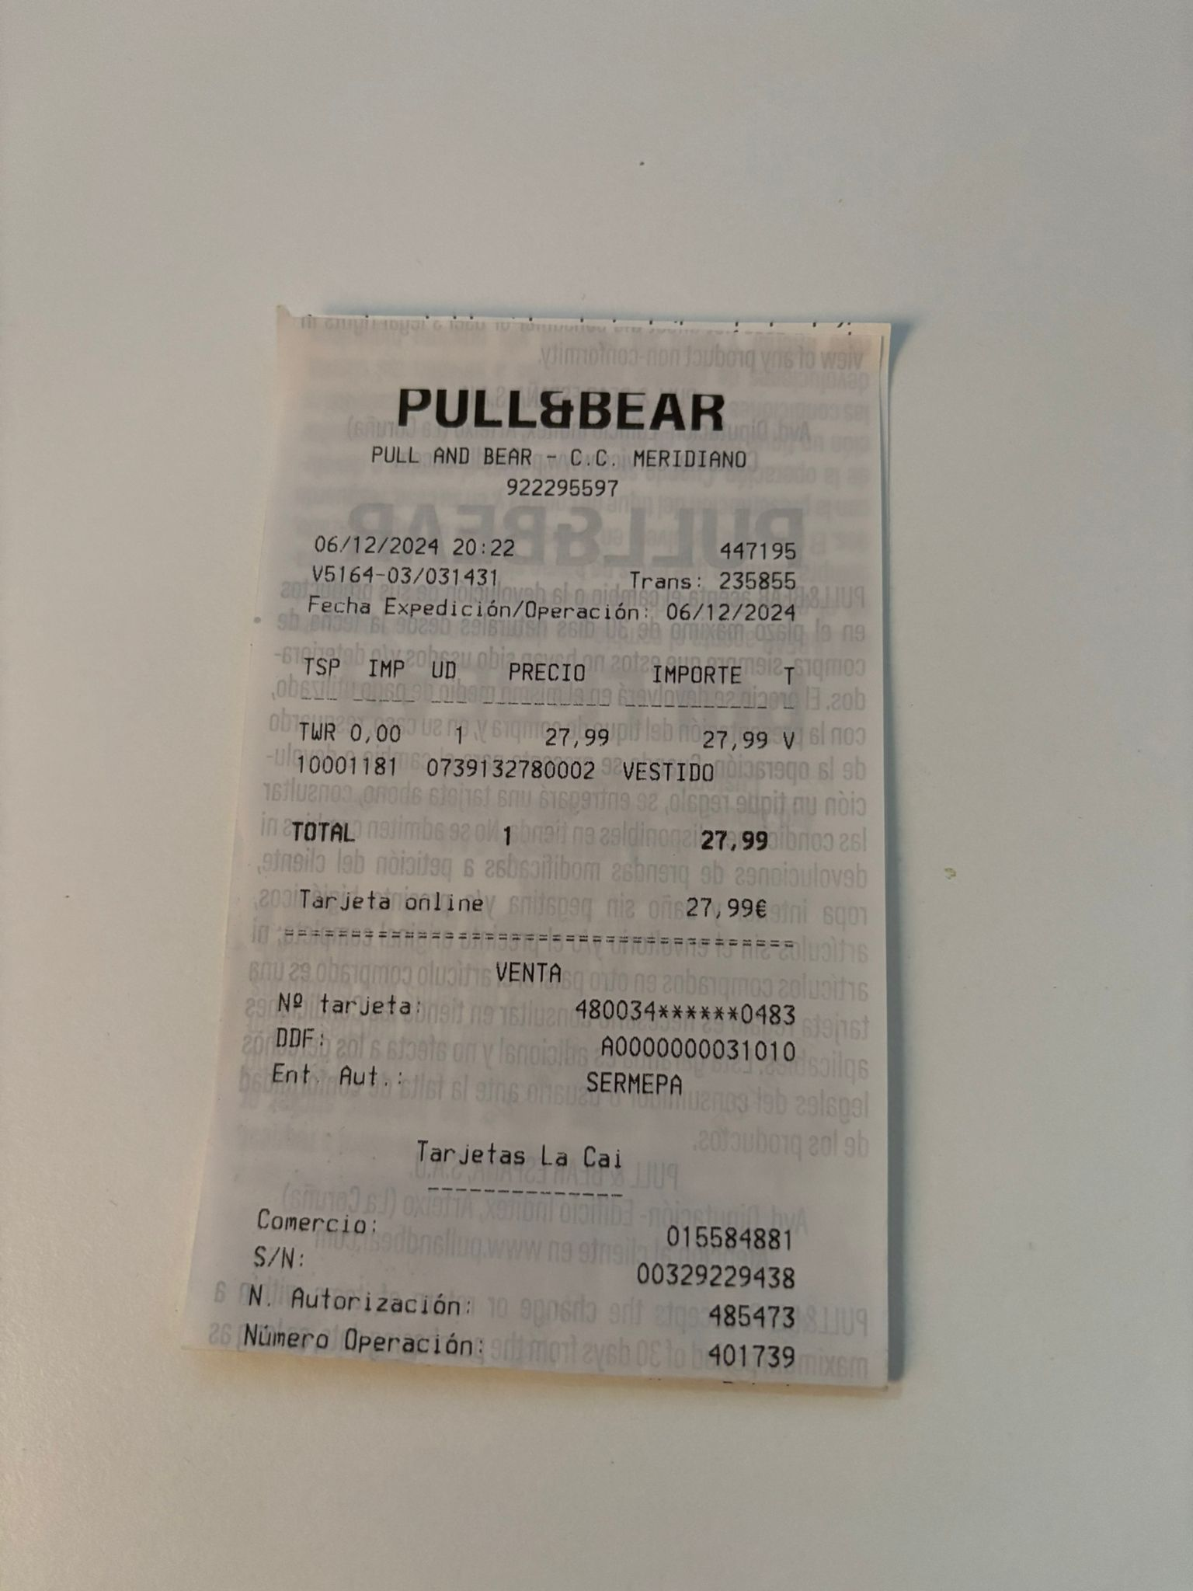
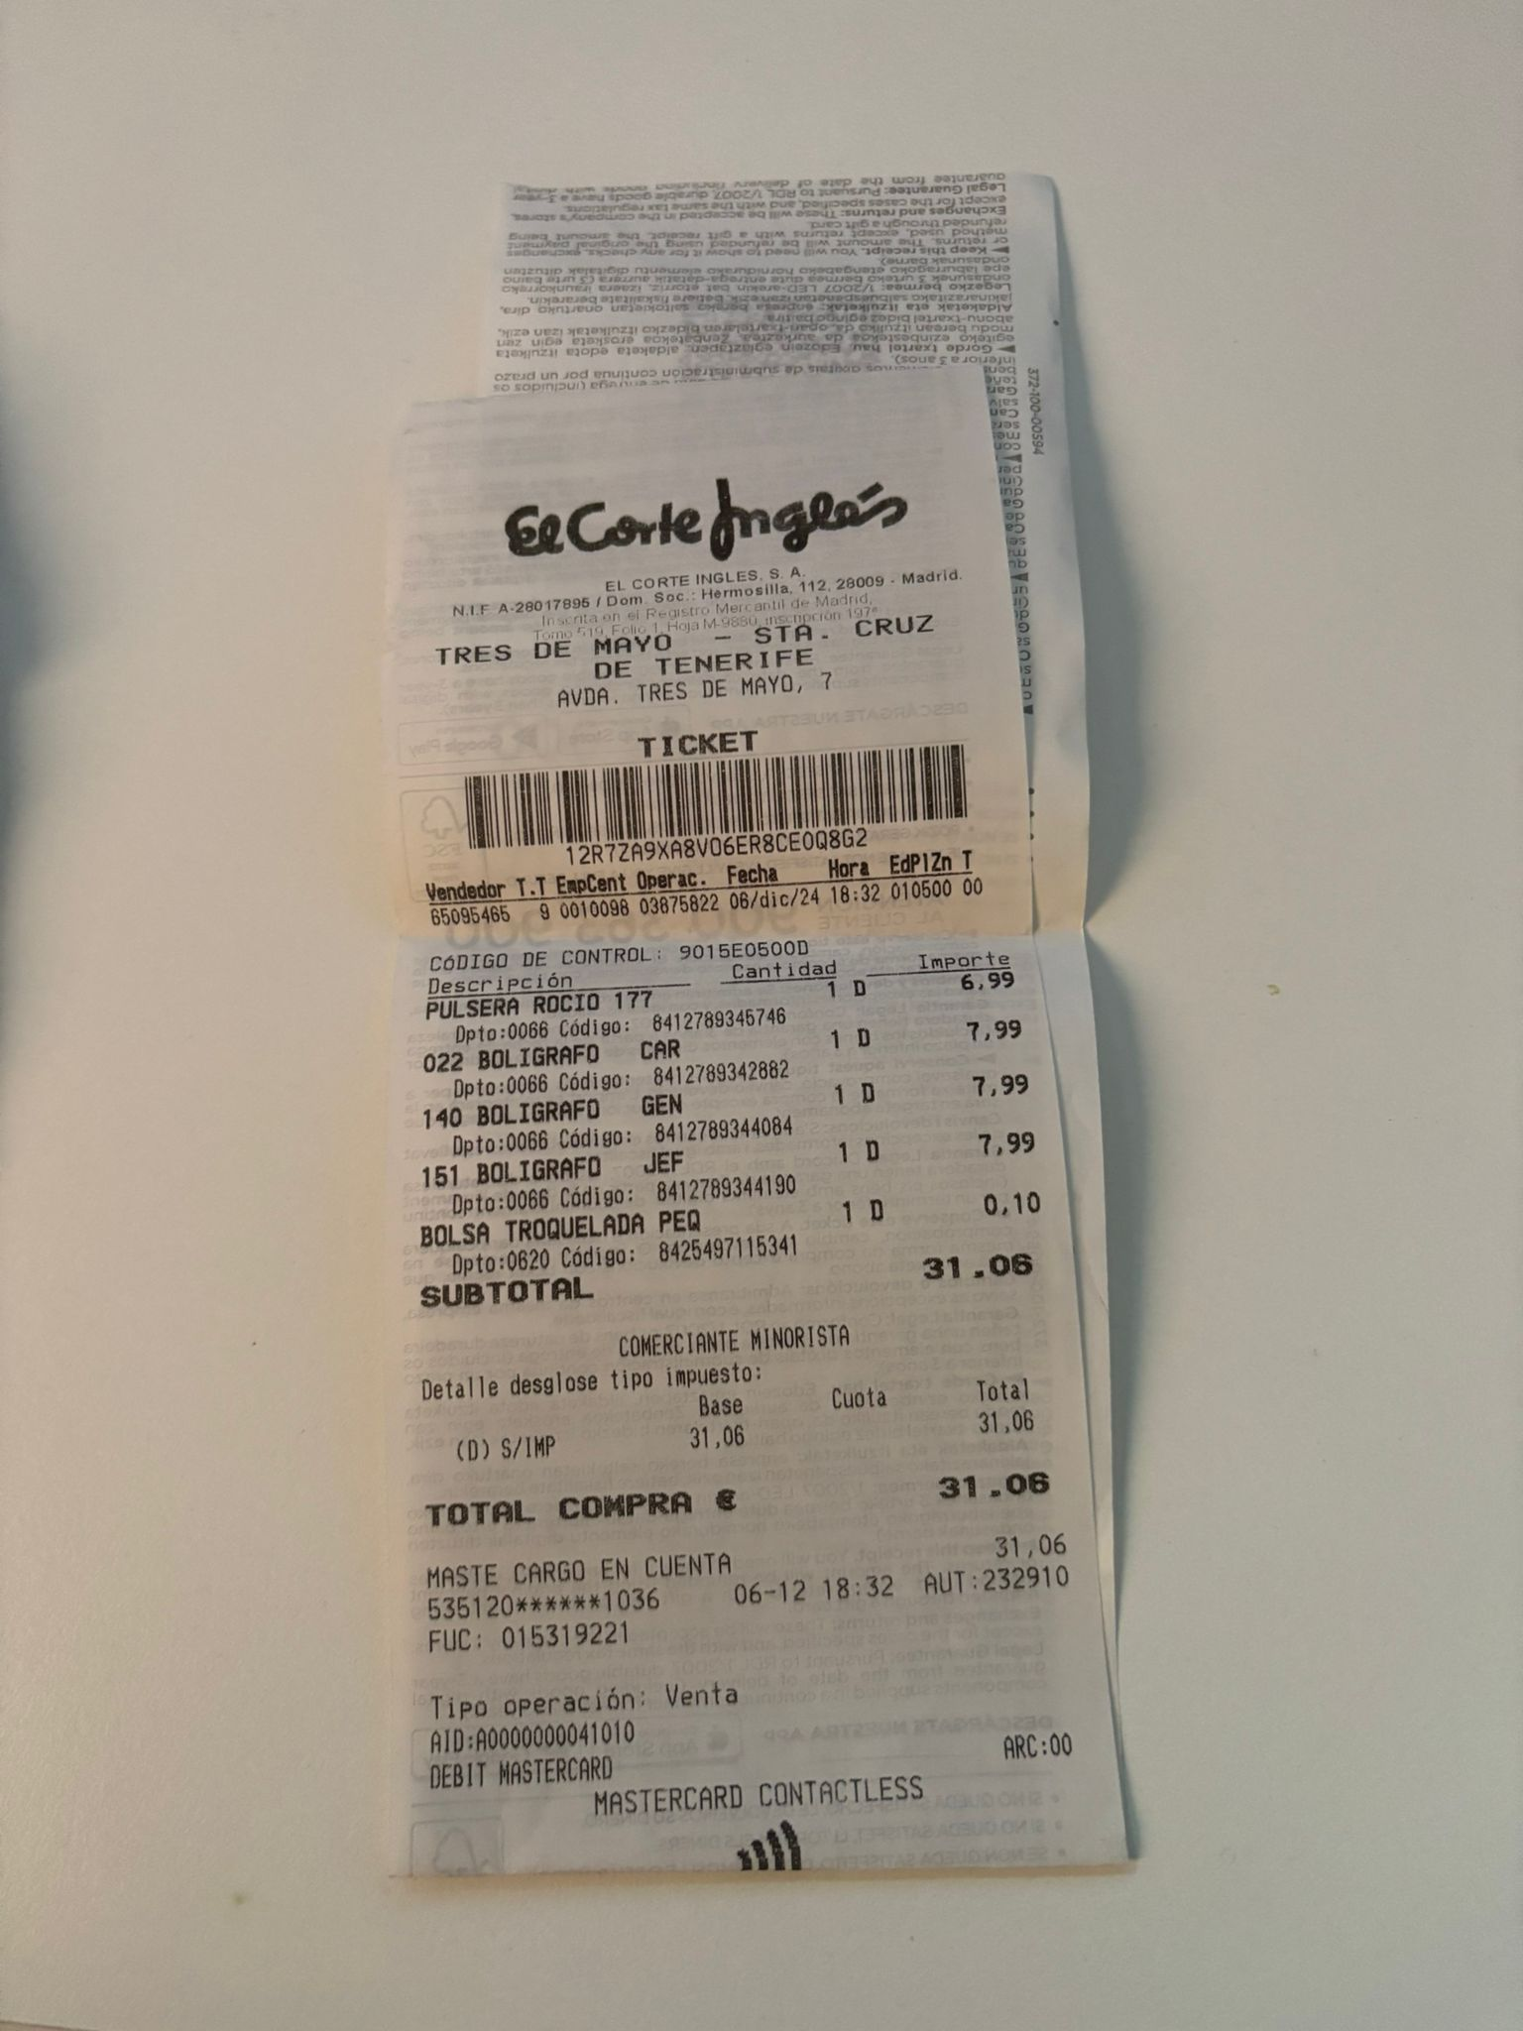
What’s about the receipts?
Azure Nigeria Community
@emimontesdeocaa
Notes:
Ok, so before we dive into the workshop I am going to quickly go over how language models work and breakdown how we can interact with them to change their output.
For a typical text generation model if we look at the image we can see they….
Receive natural language input
That input is then turned into tokens which the individual tokens are depicted by the different coloured boxes in the image
The tokens are then transformed into numbers for the model to process
The model interprets the numbers and outputs a probability distribution (a list), of the next likely tokens
The model then samples (selects) from the distribution (list), to generate the final natural language output

Slide 4
What did I built?
God bless AI for making my life easier 😭
Azure Nigeria Community
@emimontesdeocaa
Notes:
This is just another example of a phrase being transformed into tokens.
Here we can specifically see the number translation of tokens also known as vector embeddings.
You can explore how the tokenizer works more at…. Platform.openai.com/tokenizer

Slide 5
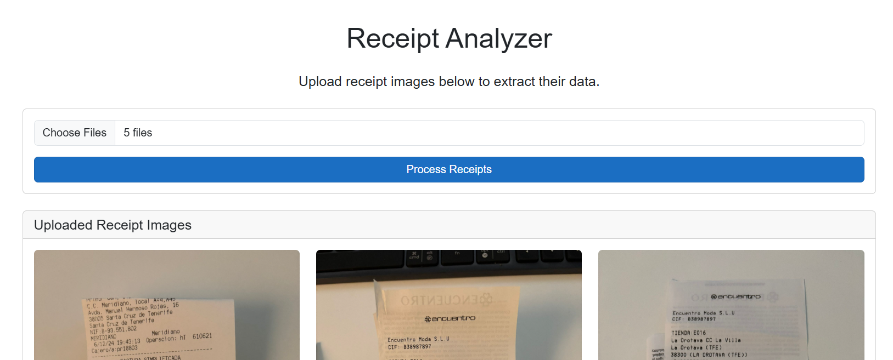
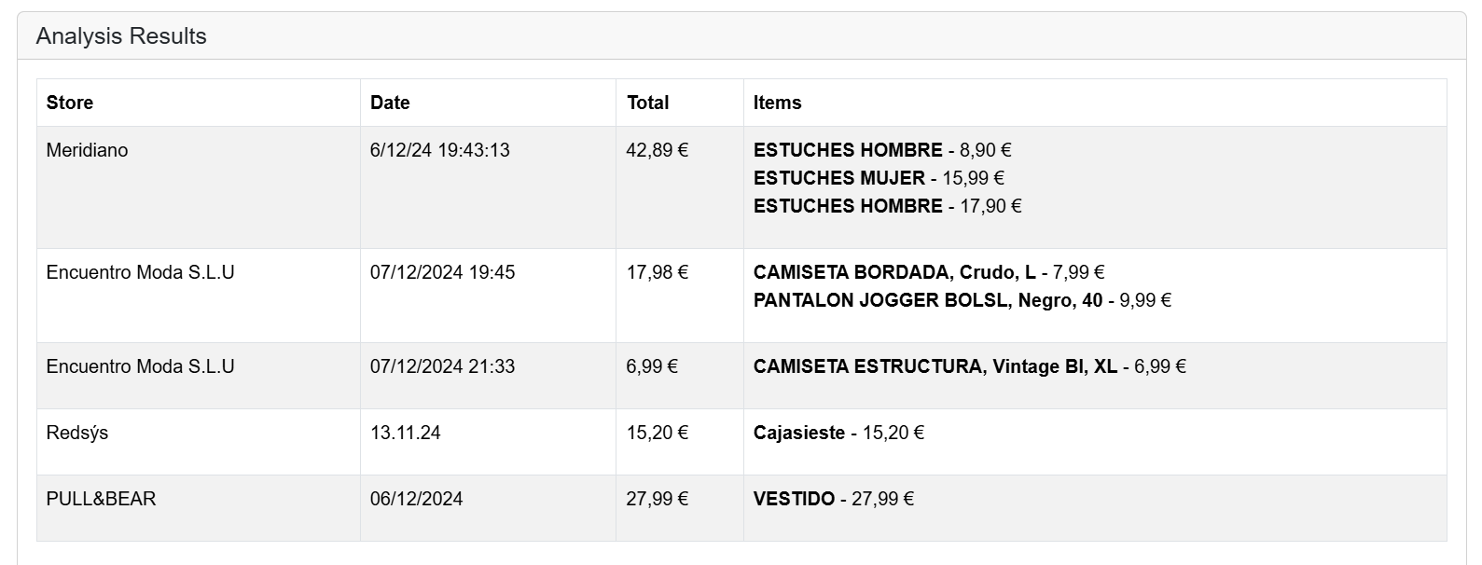
Azure Nigeria Community
@emimontesdeocaa
Notes:
The simplified idea is….
N tokens in
1 token out

Slide 6
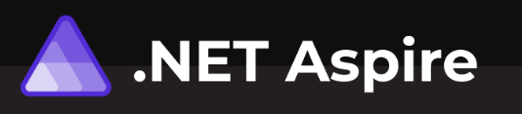
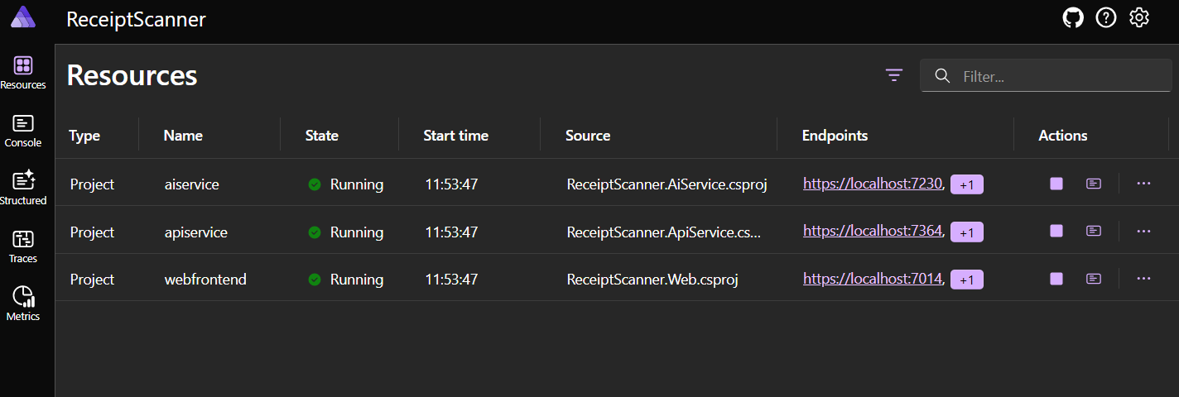
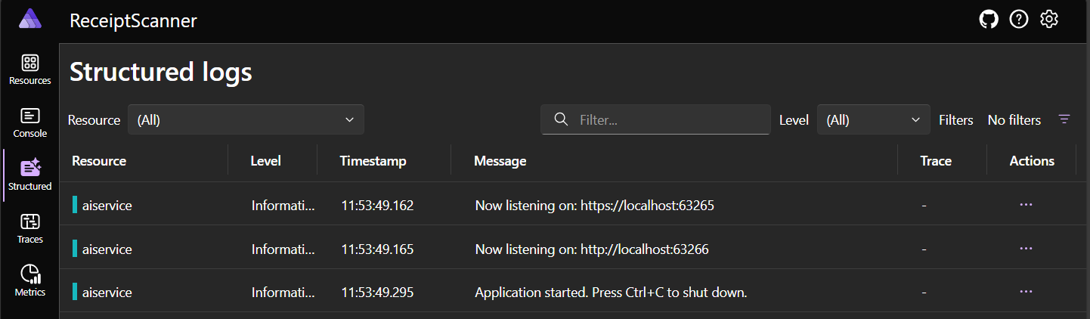
How is this built? - Infrastructure
NET Aspire is a development framework for building cloud-native applications efficiently and scalably within the .NET ecosystem.
Azure Nigeria Community
@emimontesdeocaa
Notes:
By a show of hands how many people know what a token is? (Helps gauge the general technical knowledge in the room)
For those who don’t know, to clarify on what a token is….
A token is not a letter
Or a word
In case of OpenAI
A token is a short sequence of letters
For example, a token can be we of need => because they are short and commonly used But a token can also be part of a word like “anthropomorphizing” takes 3 tokens, because it is a long word and not commonly used
This is how the tokenizer in Open Ai works

Slide 7

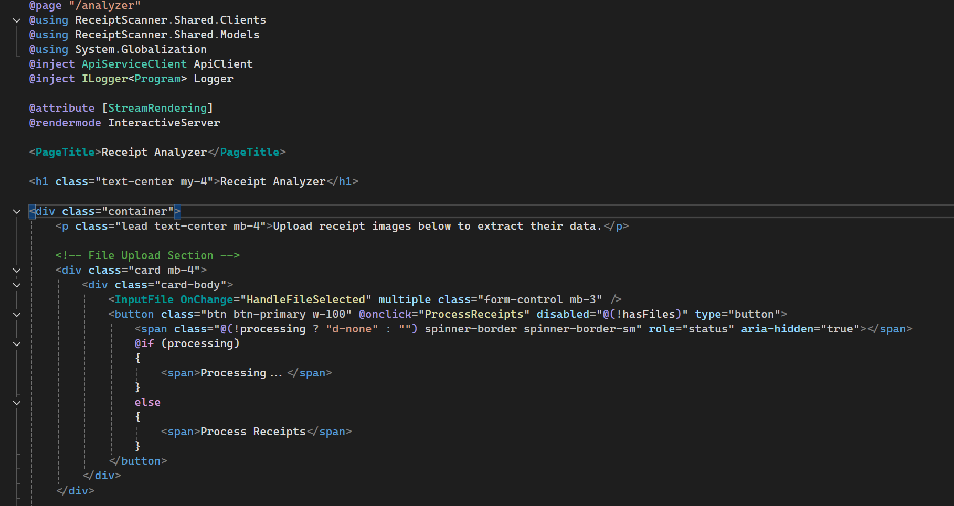
How is this built? - Webapp
Blazor is a .NET framework for building interactive and dynamic web applications using C# instead of JavaScript.
Azure Nigeria Community
@emimontesdeocaa
Notes:
By a show of hands how many people know what a token is? (Helps gauge the general technical knowledge in the room)
For those who don’t know, to clarify on what a token is….
A token is not a letter
Or a word
In case of OpenAI
A token is a short sequence of letters
For example, a token can be we of need => because they are short and commonly used But a token can also be part of a word like “anthropomorphizing” takes 3 tokens, because it is a long word and not commonly used
This is how the tokenizer in Open Ai works

Slide 8

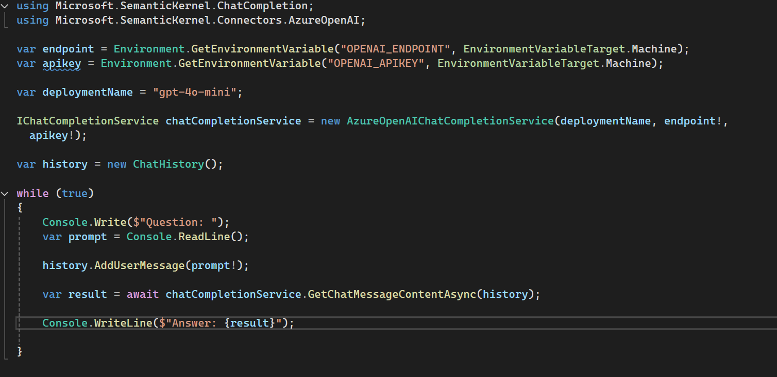
How is this built? - AI
Semantic Kernel is an SDK from Microsoft that allows integrating artificial intelligence (AI) and language models, like GPT, into applications to create smarter and more contextual experiences.
Azure Nigeria Community
@emimontesdeocaa
Notes:
By a show of hands how many people know what a token is? (Helps gauge the general technical knowledge in the room)
For those who don’t know, to clarify on what a token is….
A token is not a letter
Or a word
In case of OpenAI
A token is a short sequence of letters
For example, a token can be we of need => because they are short and commonly used But a token can also be part of a word like “anthropomorphizing” takes 3 tokens, because it is a long word and not commonly used
This is how the tokenizer in Open Ai works

Slide 9
Show me the code!
I came for this!!
Azure Nigeria Community
@emimontesdeocaa
Notes:
This is just another example of a phrase being transformed into tokens.
Here we can specifically see the number translation of tokens also known as vector embeddings.
You can explore how the tokenizer works more at…. Platform.openai.com/tokenizer

Slide 10
Thanks!
emimontesdeoca/global-ai-2025-azure-nigeria
Azure Nigeria Community
@emimontesdeocaa
Notes:
This is just another example of a phrase being transformed into tokens.
Here we can specifically see the number translation of tokens also known as vector embeddings.
You can explore how the tokenizer works more at…. Platform.openai.com/tokenizer

